Slide 1
US Healthcare Basics
Day 1
Feb 17, 2021
Trainer
Sameer Tuladhar

Slide 2
US Healthcare from a Global Perspective
Analysis highlights in a series of Commonweath Fund cross-national comparisons that uses health data from the Organization for Economic Co-operation and Development (OECD) to access US Healthcare System
Reference: https://www.commonwealthfund.org/publications/issue-briefs/2020/jan/us-health-care-global-perspective-2019

Slide 3
Highlights
The U.S. spends more on health care as a share of the economy — nearly twice as much as the average OECD country — yet has the lowest life expectancy and highest suicide rates among the 11 nations.
The U.S. has the highest chronic disease burden and an obesity rate that is two times higher than the OECD average.
Americans had fewer physician visits than peers in most countries, which may be related to a low supply of physicians in the U.S.
Americans use some expensive technologies, such as MRIs, and specialized procedures, such as hip replacements, more often than other peers.
Compared to peer nations, the U.S. has among the highest number of hospitalizations from preventable causes and the highest rate of avoidable deaths.
The U.S. outperforms its peers in terms of preventive measures — it has the one of the highest rates of breast cancer screening among women ages 50 to 69 and the second-highest rate (after the U.K.) of flu vaccinations among people age 65 and old.

Slide 4
U.S. Spends more on Health Care than any other countries
Data: OECD Health Statistics 2019
Commonwealthfund.org

Slide 5
U.S. Public Spending is similar to Other Countries; Out-of-Pocket and Private Spending are Higher than most
Data: OECD Health Statistics 2019
Commonwealthfund.org

Slide 6
U.S. has the Lowest Life Expectancy
Data: OECD Health Statistics 2019
Commonwealthfund.org

Slide 7
U.S. Adults have the Highest Suicide Rates and Chronic Disease Burden
Suicide Rates
Chronic Disease Burden
Data: OECD Health Statistics 2019
Commonwealthfund.org

Slide 8
Americans visit the Doctor less frequently and have fewer Physicians
Average physician visits per capita, 2017
Practicing physicians per 1000 population, 2018
Data: OECD Health Statistics 2019
Commonwealthfund.org

Slide 9
U.S. has a high rate of MRI Scans
Magnetic Resonance Imaging(MRI) scans per 1000 population
Data: OECD Health Statistics 2019
Commonwealthfund.org

Slide 10
U.S. has among the highest rates of Hospitalizations from Preventable Causes like Diabetes and Hypertension
Discharges per 100,000 population
Data: OECD Health Statistics 2019
Commonwealthfund.org

Slide 11
U.S. has the highest rate of Avoidable deaths
Deaths per 100,000 population
Data: OECD Health Statistics 2019
Commonwealthfund.org

Slide 12
Introduction to the U.S. Healthcare System
Reference: https://www.khanacademy.org/partner-content/brookings-institution/introduction-to-healthcare

Slide 13
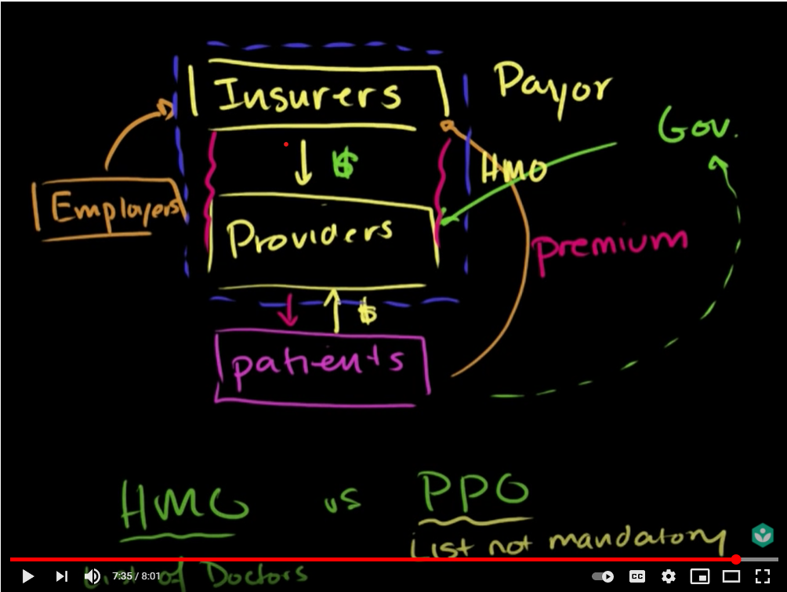
U.S. Healthcare System Overview: Market Players

Slide 14
U.S. Healthcare System: Introduction and complexity

Slide 15
Assignment 1.
1. Based on the learnings in Day 1 session, summarize your understanding on why US healthcare is complex and how patient gets the medical facilities/treatment in US Healthcare System, what are the major players of the US healthcare market involved in providing the medical as well as financial(insurance) services. Write concisely in 1000 words.

Slide 16
US Healthcare Basics
Day 2
Feb 18, 2021
Trainer
Sameer Tuladhar

Slide 17






How Does Healthcare Work

Slide 18
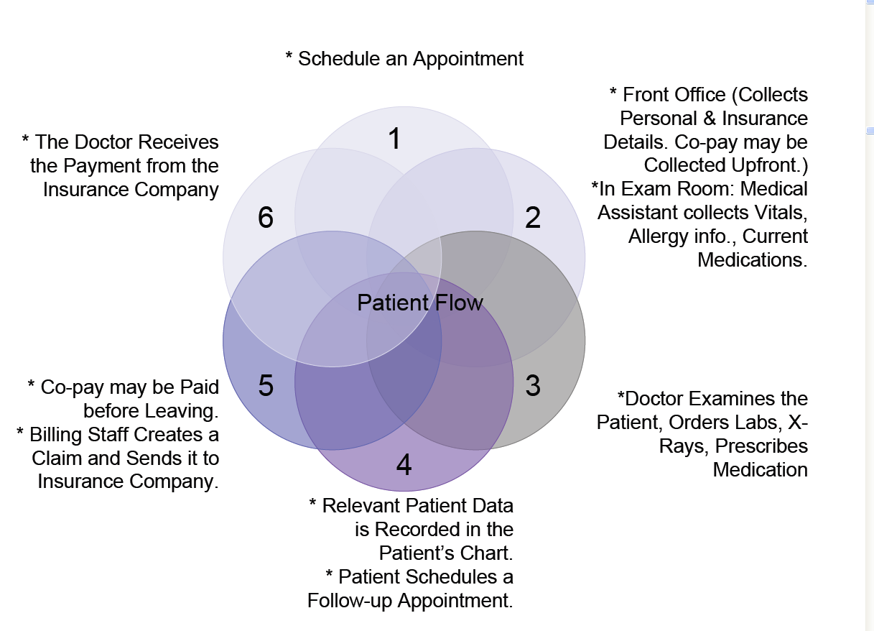
How Does Healthcare Work

Slide 19
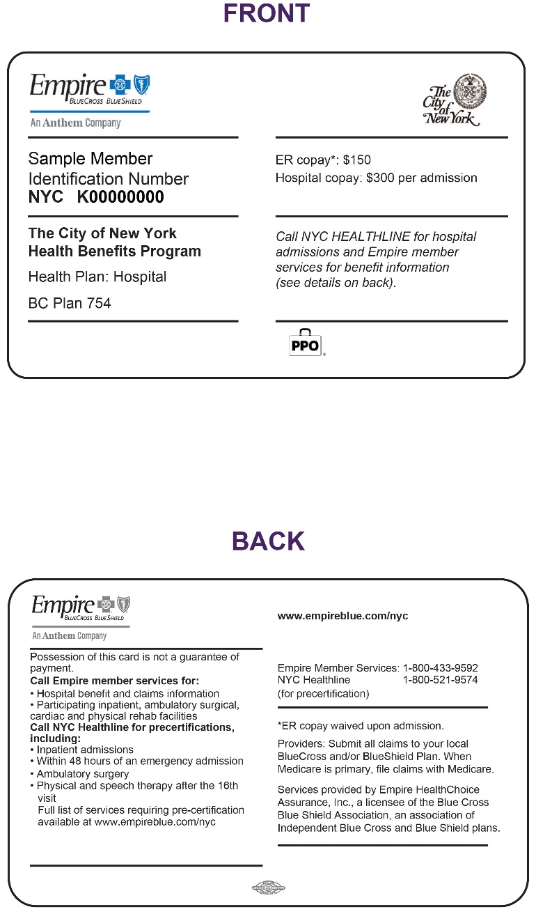
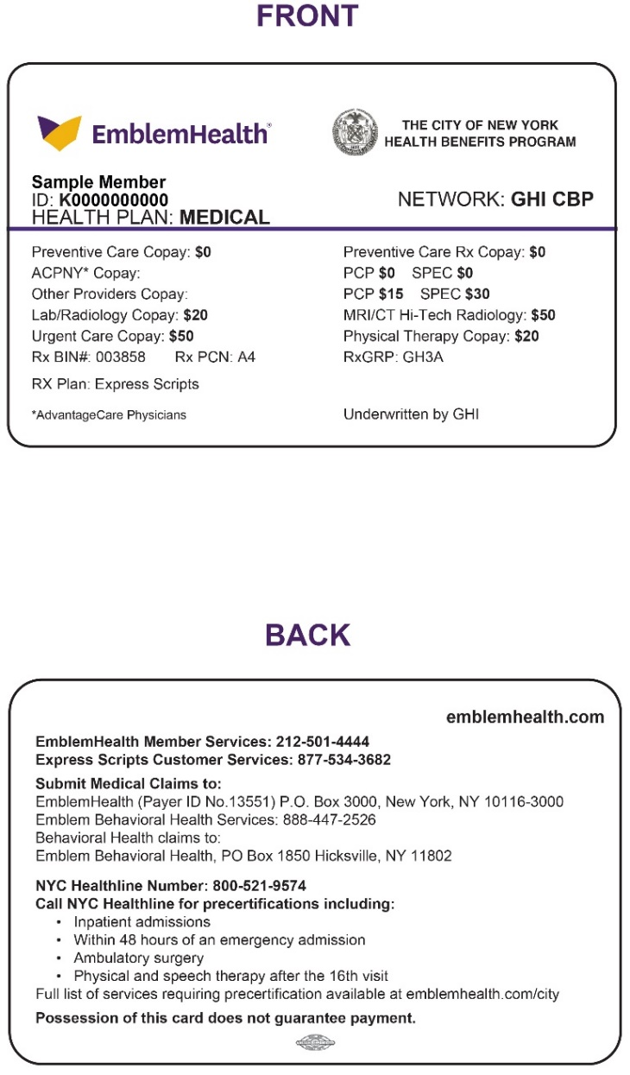
Sample Insurance Cards

Slide 20



Ways of Paying for Healthcare in the US
Out of Pocket Payment: Payment is directly made from Patient to Provider.
Individual Private Insurance(Private Non Group): A third party, the insurance plan (Health Plan) is added, dividing payment into a financing component and a reimbursement component.
EmployerBased Private Insurance (Group Insurance): Employers pay some or all of health insurance premiums to the health plan on behalf of the employee.

Slide 21

Ways of Paying for Healthcare in the US
Government Insurance: Government plans are funded by tax dollars and only certain individuals are allowed to receive benefits. Medicare and Medicaid are two types of government plans.

Slide 22

Private Health Insurance
Group (Employer) Health Insurance
Employers often pay for a part of their employee’s insurance
Fully Insured
Self Insured
Individuals
Individuals can buy health insurance directly from health insurance plan

Slide 23
Private Health Insurance

Slide 24

Public Health Insurance
Federal Government
Medicare
Medicare is a national health insurance program in the United States, begun in 1966 under
the Social Security Administration (SSA) and now administered by the Centers for Medicare and Medicaid
Services (CMS). It primarily provides health insurance for Americans aged 65 and older, but also for
some younger people with disability status as determined by the SSA, and people with end stage renal disease
and amyotrophic lateral sclerosis (ALS or Lou Gehrig's disease).
In 2018, according to the 2019 Medicare Trustees Report, Medicare provided health insurance for over 59.9 million individuals—more than 52 million people aged 65 and older and about 8 million younger people.
Medicare is divided into four Parts: A, B, C and D.
Part A covers hospital (inpatient, formally admitted only), skilled nursing (only after being formally admitted to a hospital for three days and not for custodial care), and hospice services.
Part B covers outpatient services including some providers' services while inpatient at a hospital, outpatient hospital charges, most provider office visits even if the office is "in a hospital", and most professionally administered prescription drugs.
Part C is an alternative called Managed Medicare or Medicare Advantage which allows patients to choose health plans with at least the same service coverage as Parts A and B (and most often more), often the benefits of Part D, and always an annual out-of-pocket spend limit which A and B lack. A beneficiary must enroll in Parts A and B first before signing up for Part C.
Part D covers mostly self-administered prescription drugs.

Slide 25

Public Health Insurance
State Government
Medicaid (Uninsured)
Medicaid in the United States is a federal and state program that helps with medical costs for some
people with limited income and resources. Medicaid also offers benefits not normally covered by Medicare,
including nursing home care and personal care services. The Health Insurance Association of America
describes Medicaid as "a government insurance program for persons of all ages whose income and resources
are insufficient to pay for health care.“
As of 2017, the total annual cost of Medicaid was just over $600 billion, of which the federal government
contributed $375 billion and states an additional $230 billion.[6] States are not required to participate in the program, although
all have since 1982. In general, Medicaid recipients must be U.S. citizens or qualified non-citizens, and may include low-income adults,
their children, and people with certain disabilities.

Slide 26
Medicare Program

Slide 27
Medicaid Program

Slide 28
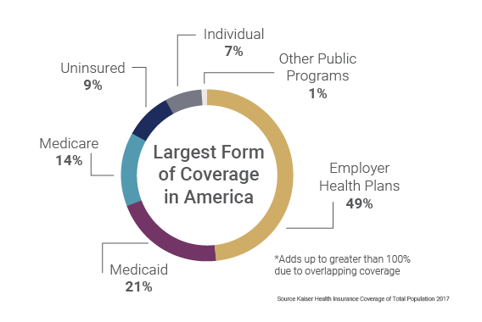
Health Insurance Coverage in the US in 2017

Slide 29
Players in the market
Physician Organizations/ Provider Groups
Physician organizations and provider groups are groups of physicians or health care providers who are financially responsible for the total care and treatment of their patients regardless of whether they themselves or unaffiliated physicians provide the care.
Examples: JSA, Thomson (Medstat), Ingenix, IHCIS, MEDai
Self-Funded Employer Groups and State Governments
Employer groups who are financially liable for all the medical claim costs of their employees are considered self-funded. They may purchase stop-loss coverage to protect them against catastrophic cases, but they pay a majority of the claims. Clients select to be self-funded for many reasons, such as they have healthy employees, they don’t want to pay for the state mandated items with full indemnity plans, or want their own choice of network.
Self-funded groups negotiate better rates with providers, networks, and stop loss carriers. They also benefit from CM and DM services to check health care expenditures.
Examples: Smiths Group

Slide 30
Players in the market
Third Party Adminsitrators(TPA)
Third Party Administrators pay claims on behalf of self-funded clients. They have a financial incentive to improve the performance of the health plan or risk losing their customer base. Because TPAs have to satisfy the demands of brokers and consultants and self-funded groups, they are constantly on the look out for potential cost savings opportunities, such as changes in networks and benefit design. TPAs may provide CM/DM services also.
Example: Wells Fargo, CBSA, UMR, Kanawha, Zywave etc.
Health Plans
Health plans are referred to as Full Indemnity, Health Maintenance Organizations (HMO), Blue Cross, Blue Shield, etc. The distinguishing feature is that they underwrite the risk of providing health care for a contract year (12 months). They are paid a flat rate each month; in return, they pay all of the claims after subtracting the amount the employees themselves pay. Companies will use a health plan versus being self-funded when they have an “unhealthy population”. Most such companies are small (under 100 employees) or do not have the financial resources necessary for self-funding of health care.
Examples: Network Health Plan, HMOI etc

Slide 31
Players in the market
Brokers and Consultants
Brokers and consultants advise companies that purchase health care coverage for their employees. Not all companies employ consultants to assist them. Brokers and consultants earn their revenue by getting a commission on the final sale of the selected coverage the client purchases, whether health plans or self-funded.
Example: AON, Lockton etc.
Stop-Loss Carriers (or Re-Insurance Groups)
Stop-loss carriers serve self-funded clients by mitigating the risk which arises due to a few individuals with extremely high health care costs. In specific coverage, the self-funded group pays all the claims for each individual until an individual’s total claims costs become greater than the threshold limit. The limit can be as low as $20,000 or go up to millions of dollars. In aggregate coverage, the self-funded group pays all the claim costs until the total claim cost for all individuals covered reaches the threshold. All types of medical plans (self-funded, fully insured etc.) use stop-loss insurance.
Examples: SunLife, Genworth, Thomson etc

Slide 32
Players in the market
Pharmacy Benefit Managers (PBM)
Pharmacy benefit managers, or PBMs, are companies that manage prescription drug benefits on behalf of health insurers, Medicare Part D drug plans, large employers, and other payers. By negotiating with drug manufacturers and pharmacies to control drug spending, PBMs have a significant behind-the-scenes impact in determining total drug costs for insurers, shaping patients’ access to medications, and determining how much pharmacies are paid.
PBMs are hired to help payer control costs
Eg: Caremark
Aso (Administrative Services Only)
An arrangement whereby an insurer agrees to provide services to a self-insured entity, such as providing printed claim forms, and processing and auditing claims. The insurer does not assume any insurance risk under an ASO arrangement.
TPA who don’t provide CM/DM services are ASO organizations

Slide 33
Assignment 2.
1. Explore in web and describe about other kind of Health Insurances that exists in US Healthcare which we have not discussed in today’s session(Private(Self-Insured & Fully-Insured) and Public(Medicare & Medicaid).
2. Explain about the roles of PBMs in US Healthcare. Why are PBMs under scrutiny for rising prescription drug costs and spending.

Slide 34
US Healthcare Basics
Day 3
Feb 19, 2021
Trainer
Sameer Tuladhar

Slide 35
Types of Healthcare Plans
Indemnity Plan
Managed Care
Health Maintenance Organizations (HMOs)
Business arrangement between Doctors, hospitals, and insurers
medical treatment on a prepaid basis (flat rate each month)
Primary Care Physicians act as Medical Gatekeepers
they underwrite the risk of providing health care for a contract year (12 months).
Low out of pocket cost for individuals, focus on wellness and preventative care
Needs PCP referral
Preferred Provider Organizations (PPOs)/Point of Service (POS)
Organizations in which insurers contract with a limited number of physicians and hospitals (“in network”) who agree to care for patients, usually on a discounted Fee-for-service basis.
Members have their choice of healthcare provider, but often pay more for using providers that are not contracted with the insurance company. (In and out of network )
No Need of PCP referral

Slide 36
Claims Processing Work Flow

Slide 37


How is medical claim generated?
CMS 1500 Professional 1500
UB 04 Facility (Hospital, Nursing Home)

Slide 38
Amount Factors
Billed Amount
This is the total charge amount of the service submitted by the service provider.
Paid Amount
The amount paid by HMO, TPA or self insured to the service provider. It is a net paid amount or amount after deducting all plans cost or amount.
Co-Insurance
Co-insurance refers to money that an individual is required to pay for services, after a deductible has been paid. Co-insurance is often specified by a percentage. For example, the employee pays 20% toward the charges for a service and the employer or insurance company pays 80%.
Co-pay
The amount paid by member at the time of service. This is fixed amount specified by the medical plan design
Deductible
The amount an individual must pay for health care expenses before insurance (or a self-insured company) covers the costs. Often, insurance plans are based on yearly deductible amounts.
Not Allowed Amount
This represents charges that were not allowed since they were outside the benefit plan design. Although Not Allowed is also a kind of employee paid amount, we are not going to add it in our report directly. Eventually it is paid by Employee. In other words, it is the amount not covered by the plan.
Allowed Amount
This represents charges that were allowed since they were recognized by the benefit plan design.
Network/PPO Savings
It is the dollar amount of savings or discount generated by the client for having consulted a provider affiliated with a network. PPO meaning participating provider organization give certain amount of discount out of Billed Amount for using its service.
Employee Paid
Employee paid is neither Allowed nor Not Allowed Amount. It’s sum of paid amount which should have to pay by the employee. Copay, Coinsurance, Deductible are considered Employee Paid Amount. Not Allowed Amount is also paid by employee but not considered for adjudication in employee paid.
Co-ordination of Benefits
Amount paid by secondary payer(insurance) if the employee has multiple insurance plans

Slide 39
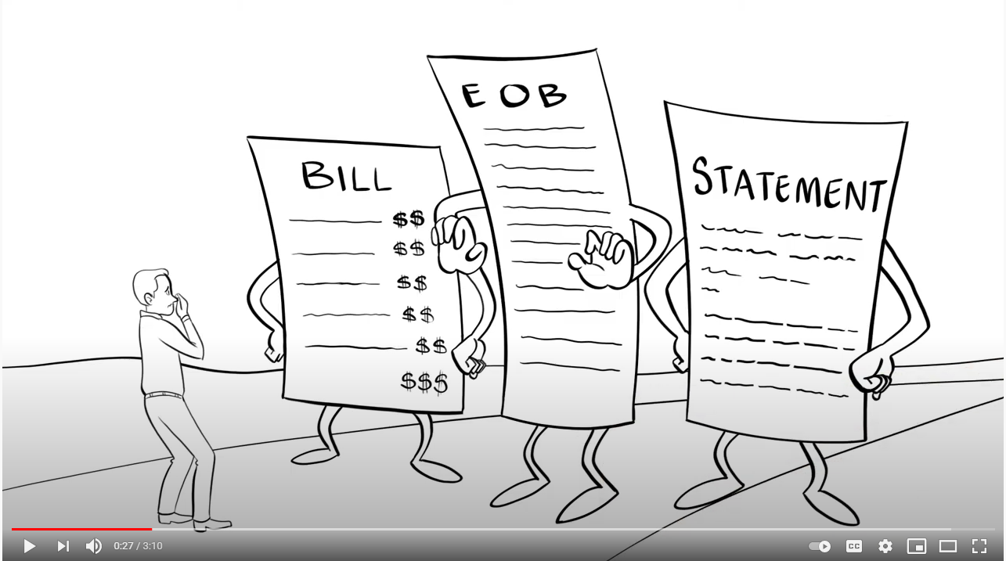
Understanding Medical Bill

Slide 40
Understanding Medical Bill

Slide 41
Two Claim Forms: CMS-1500 and UB-04

Slide 42
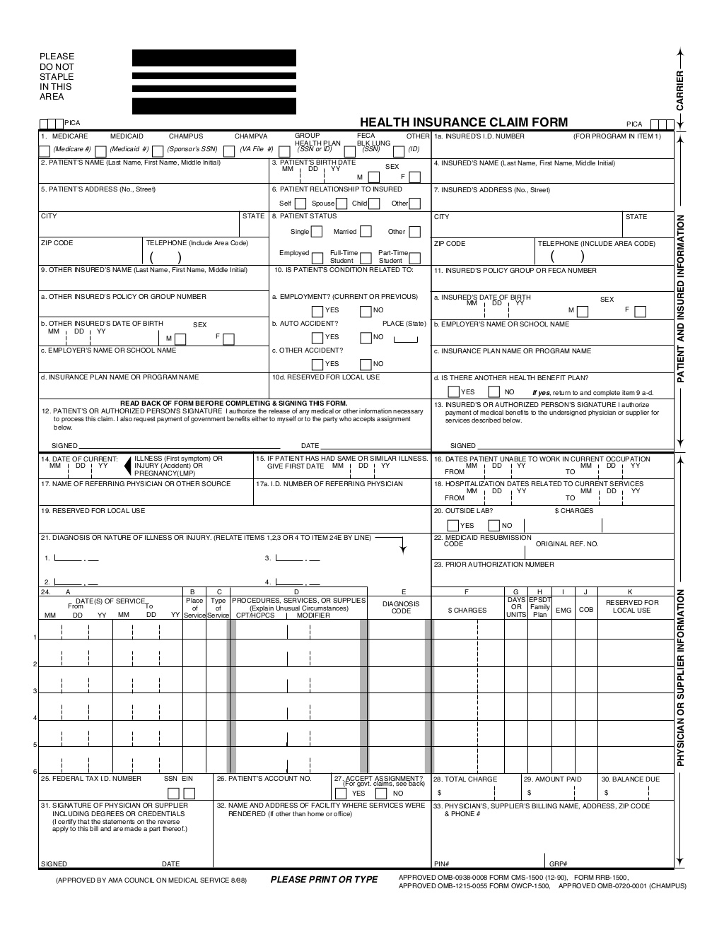
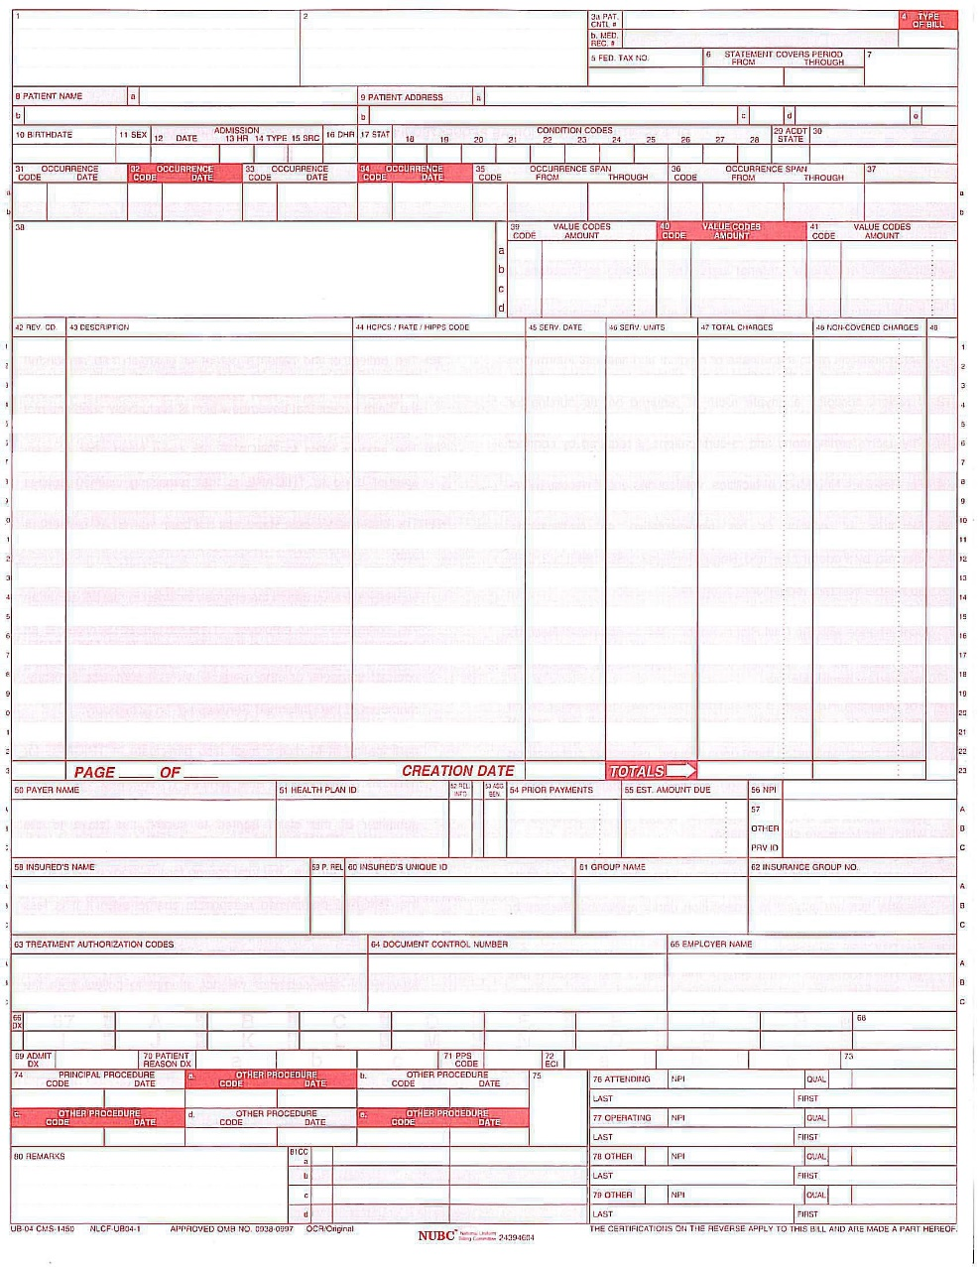
Professional Claims: CMS 1500 & Facility Claims: UB 04

Slide 43
How do Facilty and Professional Claims Differ

Slide 44
Claim Header vs. Claim Lines

Slide 46
UB-04 – Example (Inpatient)

Slide 47
CMS-1500 – Professional Claim Example

Slide 49




How is Pharmacy Claims generated?

Slide 50
Pharmacy claim process
Patient
PCP
Pharmacy Retailer
Fill/ Dispense
Pay back to PBM
Show insurance card
Copay, Deductible applied
PBM/ Payer
PBM pays the amount to retailer and sends the file/ dates to Payor
Ins company
Govt
ASO
TPA
Employer
Retailer gives medicine to patient and sends record to PBM
Get medicine with dose note

Slide 51
Assignment 3.
1. Study and explore on Professional claims and Facility claims along with billing forms CMS-1500 and UB-04 and also medical claim flow process chart in the slide. Come with queries for discussion and be prepared for giving answer to questions your friends are going to ask.
2. Go through the content of 3 days session as well. It will be helpful. ☺

Slide 52
US Healthcare Basics
Day 4
Feb 22, 2021
Trainer
Sameer Tuladhar

Slide 53
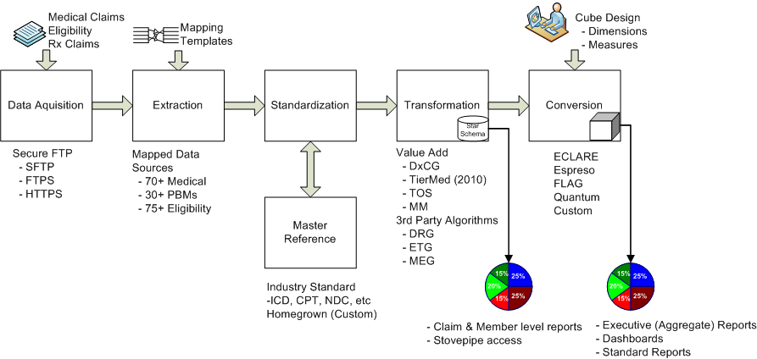
Data Aggregation Process Overview

Slide 54
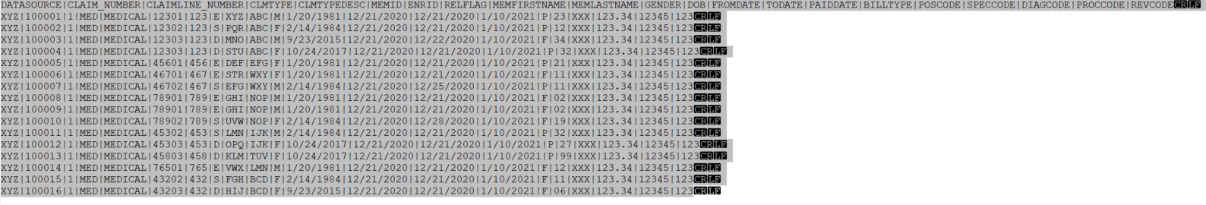
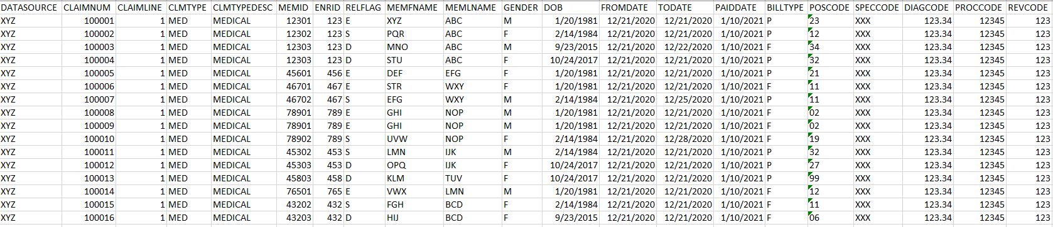
Raw files from client

Slide 55
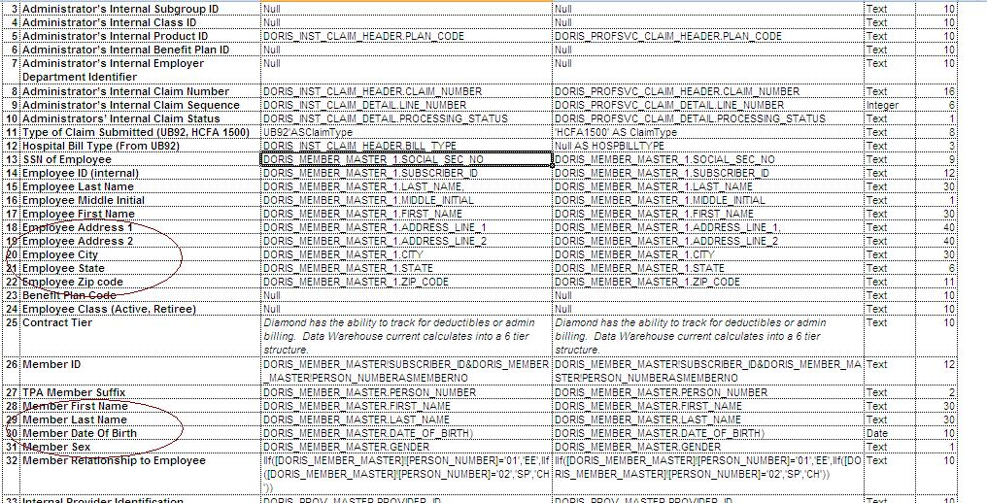
Data Dictionary and Layout

Slide 56
TYPE OF DATASETS
Standard Datasets
Eligibilities
Claims
RxClaims
Non-Standard Datasets
Health Risk Assessments
Lab
Wellness
FMLA
Program Management
Disability
Crosswalks

Slide 57
Assignment 4.
Explore the contents in following links:
https://www.cotiviti.com/solutions/payment-accuracy
https://www.cotiviti.com/solutions/risk-adjustment
https://www.cotiviti.com/solutions/quality-and-performance

Slide 58
US Healthcare Basics
Day 5
Feb 23, 2021
Trainer
Sameer Tuladhar

Slide 59
DxCG Risk Solutions (DxCG) Suite
Chosen by CMS and the governments of Germany, Chile and Abu Dhabi to strategically allocate healthcare funding.
Capabilities include:
Predictive accuracy across multiple applications.
Best-in-class predictive modeling technology combined with advanced analytics to manage risk, improve health outcomes, and containing costs.
Clinical transparency models founded on straight-forward and easy-to-understand clinical principles.
Developed by physician experts and empirical analysis using a nationally representative database

Slide 60
How DxCG Risk Solutions Works
What it does
How it is used
Groups diagnosis codes into medical condition classes using a classification system
Applies models to data to produce output
Passes output to one of our canned reports, to a 3rd party reporting system, workflow application, or a Cotiviti product
Presents a comprehensive clinical profile of an individual or group
Creates disease identification criteria for selecting individuals for a care management program, or disease registry
Measures the illness burden of individuals

Slide 61
Medical Intelligence (MI) Suite
Capabilities include:
Detection of high risk members or groups using proven predictive models.
Clinically sound quality and risk measures to pinpoint opportunities to improve care and reduce costs at both the individual and population levels.
Executive dash-boarding and employer reporting
Data importing and reporting tools to leverage HRA and disability data and gain insight on total health and productivity measures.
Tools to compare various health and pharmacy plan alternatives and visualize the financial impact of plan changes on future costs and coverage.
Identify, measure, manage and reduce financial and clinical risk – at the population and individual level

Slide 62
Medical Intelligence Key Features & Functions
Pharmacy Claims Data
Case Management Data
Virtual Medical Record for All Eligible Members
VMR Office Visits All Rx All Hospital All X-ray All Rad. All Lab All Costs All Proc. All Diag. All Specialty All Claims All Costs
Case Management
HRA Data
Cotiviti
Eligibility Data
Medical Claims Data
Disease Management
Turning Data into Knowledge into Action
Understand Risk
Pinpoint Cost Control Opportunities
Increase Quality of Care
Results:

Slide 63
Why do clients buy Medical Intelligence?
To proactively identify opportunities to improve individual health, healthcare quality, and continue to positively impact health benefit and reduce costs across the managed population.
To help identify the high-risk, potential high-cost members prior to beginning the outreach workflow.
To identify, measure, manage and reduce financial and clinical risk – at the population and individual level.
To demonstrate service excellence and value to their clients .
To make need-based decisions about deploying medical management resources.
To outsource data aggregation capabilities

Slide 64
How does Medical Intelligence deliver value?
By feeding care managers only those patients that fit a pre-determined profile (consistent with a cost containment and improvement in care strategy).
By prioritizing members by risk, so that care managers focus resources first on those where they can have the greatest impact on health status.
By helping to intervening on potential high-cost patients today will contain client costs tomorrow.
By producing clinical and financial scorecards for each member for use by providers and members.
By providing custom letters for members and providers.
By profiling providers by clinical outcomes and guideline compliance.
By providing clients with easy and reliable reporting

Slide 65
Overview: Who Buys Medical Intelligence?
Segment | Primary Use/Goals
Brokers/Benefit Consultants | Reporting, Benefit design, financial risk identification
Third Party Admin (TPA) | Reporting, Care Management, Demonstrate Service excellence, cost control
Re Insurers | Reporting, financial risk identification, pass thru as value-add software for its Care Management clients
Disease Management Co | Care Management, Demonstrate Service excellence, cost control, reporting
Health Plans | Support Care management arm of the health plan when done in house
Employers | Reporting, Care Management, Improve wellness of Employees, Improve Employee productivity, cost control, reduction in lost productivity
Providers | Care Management/Intervention, Quality Improvement, Demonstrate Service excellence to patients and to payers, cost control for at risk groups

Slide 66
Enterprise Analytics (EA) Suite
Capabilities include:
Data acquisition and warehousing
Executive Summary drill down and customizable business intelligence layer
Client reporting interface
Web-based drillable analytics and real-time glossy reports
Support of a full range of best-in-class DxCG predictive models
Rapid data transformation, loading and presentation
Integrates online analytics, executive reporting, and custom dashboards through a single interface.
Integrates data from many sources into a common warehouse to deliver consistent, accurate results.

Slide 67
Conceptual Diagram: Enterprise Analytics
Business Intelligence Suite
Raw Data
USTART: ETL
End Users:
Client Portal
UWg, Actuarial, HCE
DCGs
DRGs
FLAG
EClare
ETGs
Espresso
Account Managers
Employer Groups
Care Management
Viewer
Medical Director/Provider Relations => Providers
Rules Engine
Quality Measures Cube
3rd Party Portal
Case Managers
Patient/Members

Slide 68
Why do clients buy Enterprise Analytics?
Cost Containment.
Standardization of internal metrics & portability of technology across departments.
Aggregate, cross departmental reporting views to inform better business decisions and to gauge progress and efficiency.
Demonstration of service excellence and value to their clients .
Connect the healthcare community internally and externally.
Quality Measurement.
Very fast data refreshes.
Common Buyer Goal
To create one source of truth that creates prioritized and consistent messages at every touch point.

Slide 69
Performance Measurement (PM) Suite Industry-leading toolset for developing and integrating HEDIS® software
Capabilities include:
Ability to analyze claims data, enter medical record data and submit data to NCQA quickly and easily.
Ability to view, query, analyze, and measure HEDIS data using standard or custom specifications, filters or drills.
Tools to calculate HEDIS measures quickly and accurately using fully NCQA-certified software.
Ability to collect HEDIS administrative and hybrid medical record data quickly and easily.
Secure, web-enabled software that facilitates the communication, planning, and managing of projects and checkpoints related to HEDIS measure production.
Achieve 100%
Compliance for health procedures
among your members.
View results in real-time for each HEDIS measure, sample, and chase calculation
performed.

Slide 70
Performance Measurement What is HEDIS?
HEDIS = Healthcare Effectiveness Data and Information Set
Name recently changed (July 2007), was ‘Health Plan Employer Data Set’
Created in 1993 by National Committee for Quality Assurance [NCQA]
Used by more than 90% of HPs to measure performance
Consists of 71 measures across 8 domains of care
Examples of HEDIS Measures:
Asthma Medication Use
Controlling High Blood Pressure
Cancer Screening

Slide 71
Who Buys Performance Measurement (HEDIS Reporting)
Primary Market: Health Plans that are required to file HEDIS
Medicare Advantage Plans
Special Needs Plans
Commercial HMOs
Medicaid
Secondary Market: Health Plans and other players that are not required to file HEDIS but do so for marketing purposes or as a way to measure success of quality initatives
PPOs
Other non-mandated HPs, State contracts QIOs
IPAs
Marketing, P4P transparency, Medical Home, patient targeting
Channels : EHRS, Portals, Wellness, Employers, DM Companies, TPAs
Hospitals, rural health clinics etc.

Slide 72


Cotiviti Snapshots
Finding answers to the hardest questions…
Who are my highest users of health care resources?
Who will emerge as the highest users of resources in the future?
Which providers are doing the best job of managing risk in my population?
Which providers are doing the most efficient job of managing care?
Q
How are my health care dollars being spent?
How do I quantify risk?
How effectively are my current health care solutions performing to improve care and reduce cost?
Who in my population is at risk because of the quality of care they are getting?

Slide 73
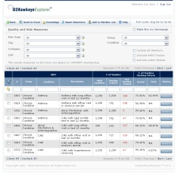



Products and Services Positioning
How Customers use Cotiviti solutions?
Analyze, stratify and group Consumers by risk & disease type
Clinical Users
Financial Users
Drill-down to Consumer’s record to intervene to improve his/her care
Strategic Users
Evaluate Care Quality and monitor for existing and potential adverse events in large populations
Consumers
+
+
=

Slide 74
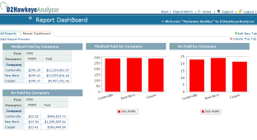
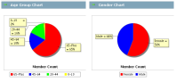



Products and Services Positioning
How Customers use Cotiviti solutions?
Aggregate complex information into simple, informative views
Discover key drivers of Medical and Pharmacy cost. Predict financial exposure and risk.
Maximize revenue opportunities from Customers and other sources
Clinical Users
Financial Users
Strategic Users
Consumers
Benefit maximization

Slide 75
Products and Services Positioning
How Customers use Cotiviti solutions?
Plan new Financial and Medical Risk Management Strategies
Design Benefit Plans to better serve my Consumers, and incentives for Vendors, Providers and Consumers
Share information strategically across my Enterprise
Clinical Users
Carve-out
Case Management
Financial Users
Strategic Users
P4P
HSA
CDHP
Consumers
Interactive Portals
Data Marts
Reports

Slide 76





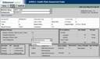
Products and Services Positioning
How Customers use Cotiviti solutions?
Provide Answers to Consumers’ Basic Questions:
Clinical Users
Financial Users
What were my medical and drug costs last year?
When did I last see Dr. Jones?
What drug was my daughter taking?
How much money should I save for health insurance?
Strategic Users
Capture Consumer perception of Health: Health Risk Assessment
Consumers

